Slide 1

Huffman Codes, cont’d
CLRS Chapter 16.3

Slide 2
How to Construct a Huffman Tree
We will construct the tree that we saw on the previous slides using character frequencies.
We will keep combining two nodes with the two lowest frequencies, f and f’, and the new node will have frequency f + f’
We will stop once all nodes are combined into a tree.
The edges of the tree will be labeled so each node goes to left child on a 0 and right child on a 1.
This will give us the tree/code we used to convert between binary code/our alphabet

Slide 3
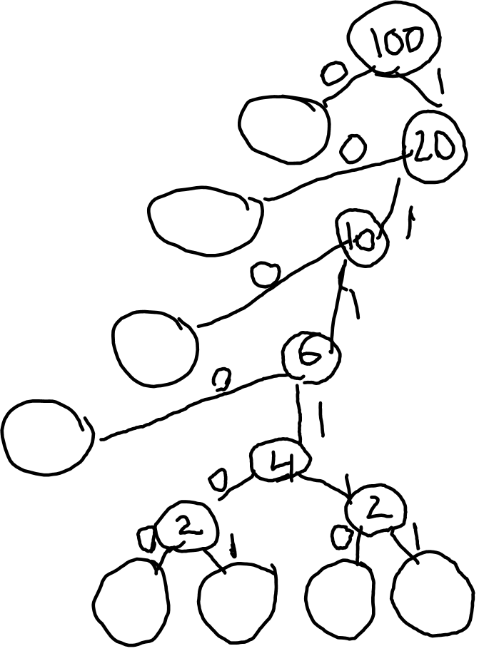
How to Construct a Huffman Tree
A: 80
B: 10
C: 4 A:80
D: 2
E: 1 B:10
F: 1
G: 1
H: 1 C:4
D:2
E:1 F:1 G:1 H:1

Slide 4
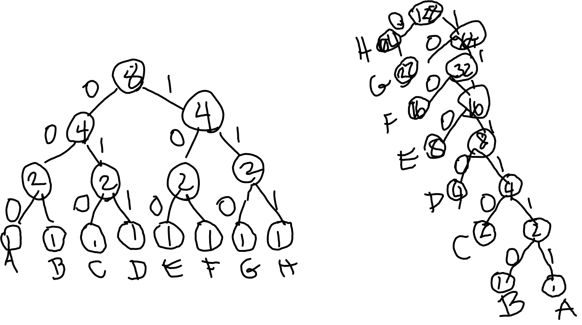
Huffman Tree Examples
Even frequencies will result in a “bushy” tree; skewed frequencies will give “skinny” tree.
A: 1 A: 1
B: 1 B: 1
C: 1 C: 2
D: 1 D: 4
E: 1 E: 8
F: 1 F: 16
G: 1 G: 32
H: 1 H: 64

Slide 5
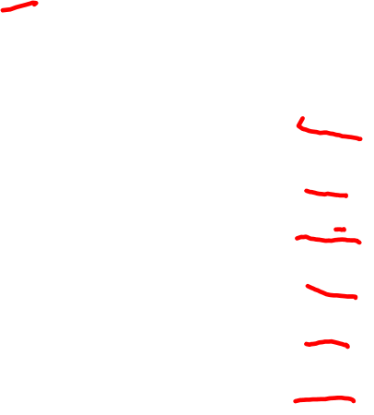
Pseudocode for Constructing Huffman Code
Huffman(C)
n=|C|; Q=C (Q is a binary min-heap)
for I = 1 to n-1
x = EXTRACT-MIN(Q)
y = EXTRACT-MIN(Q)
allocate a new node z
z.left = x; z.right = y;
z.freq = x.freq + y.freq
INSERT(Q, z)
Return EXTRACT-MIN(Q)

Slide 6
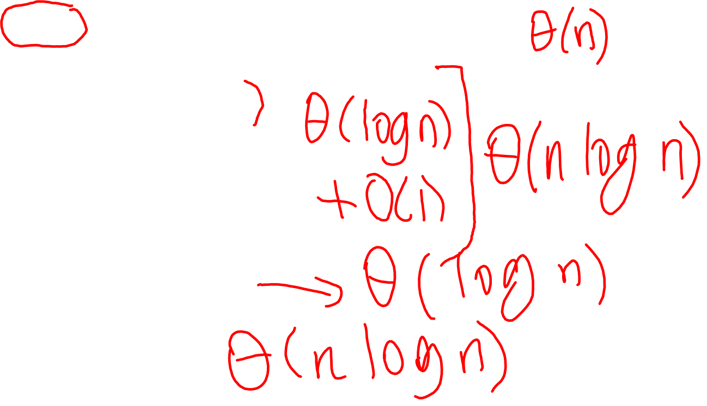
Analysis of Huffman Tree Algorithm
Huffman(C)
n=|C|; Q=C (Q is a binary min-heap)
for I = 1 to n-1
x = EXTRACT-MIN(Q)
y = EXTRACT-MIN(Q)
allocate a new node z
z.left = x; z.right = y;
z.freq = x.freq + y.freq
INSERT(Q, z)
Return EXTRACT-MIN(Q)
Θ(n log n) altogether
Returns optimal Huffman Tree

